Slide 1

IST-718 Big Data Analytics
Project Title New Zealand Domestic Air-fare PREDICTION
Project By
JASDEEP SINGH MONGA-414509580
PRIYA RAO-660997227
YunHUai CAO-358813275
Group Number
19
Project UNDER
Professor Emory Creel
MA Physics
M.S. Probability and Statistics
12/6/22

Slide 2
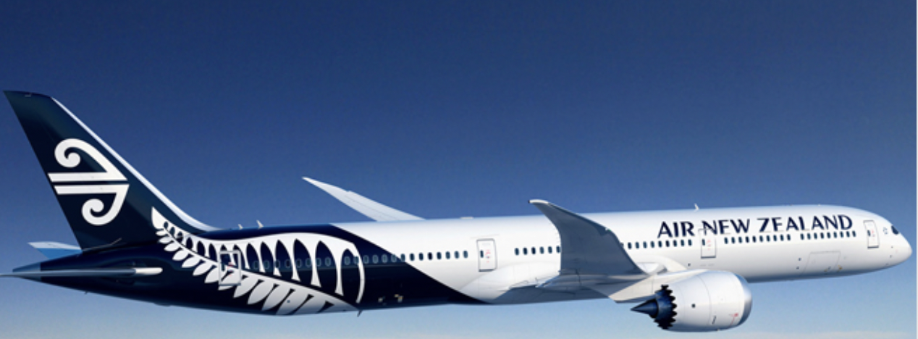
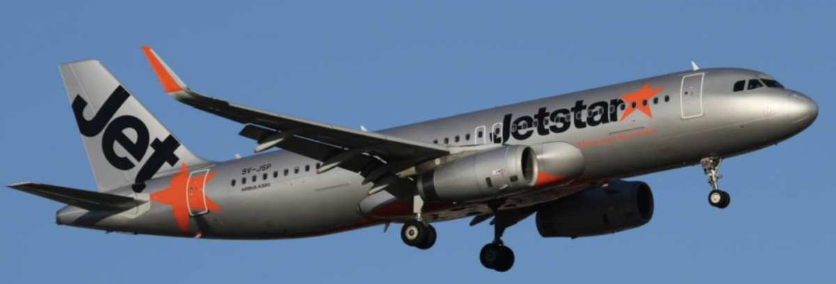
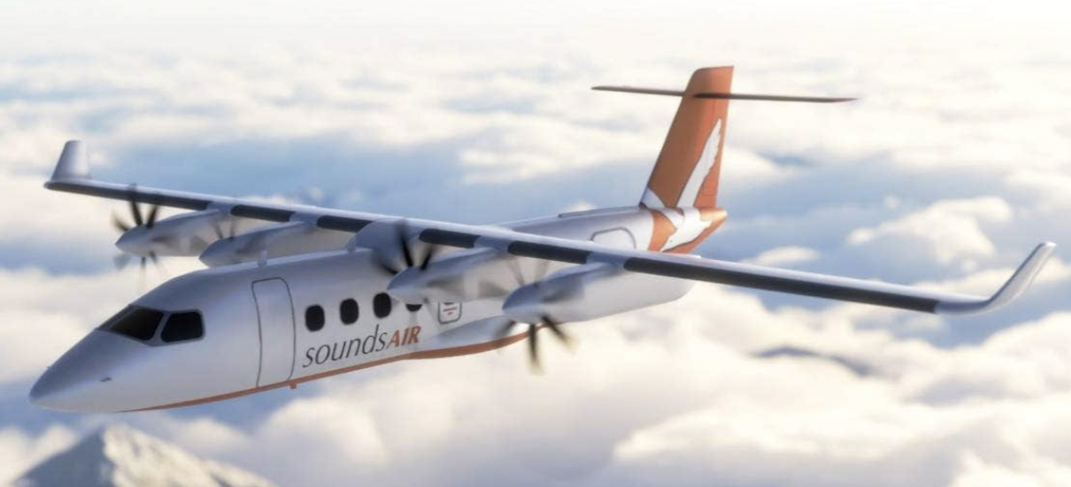
Business Objective
The data set displays domestic airfares for New Zealand airlines on various domestic routes, especially for Air New Zealand, Jetstar, and SoundsAir.
Based on the above characteristics, the airlines compete with one another to predict domestic fares for various New Zealand carriers.
Jetstar
Air New Zealand
SoundsAir

Slide 3
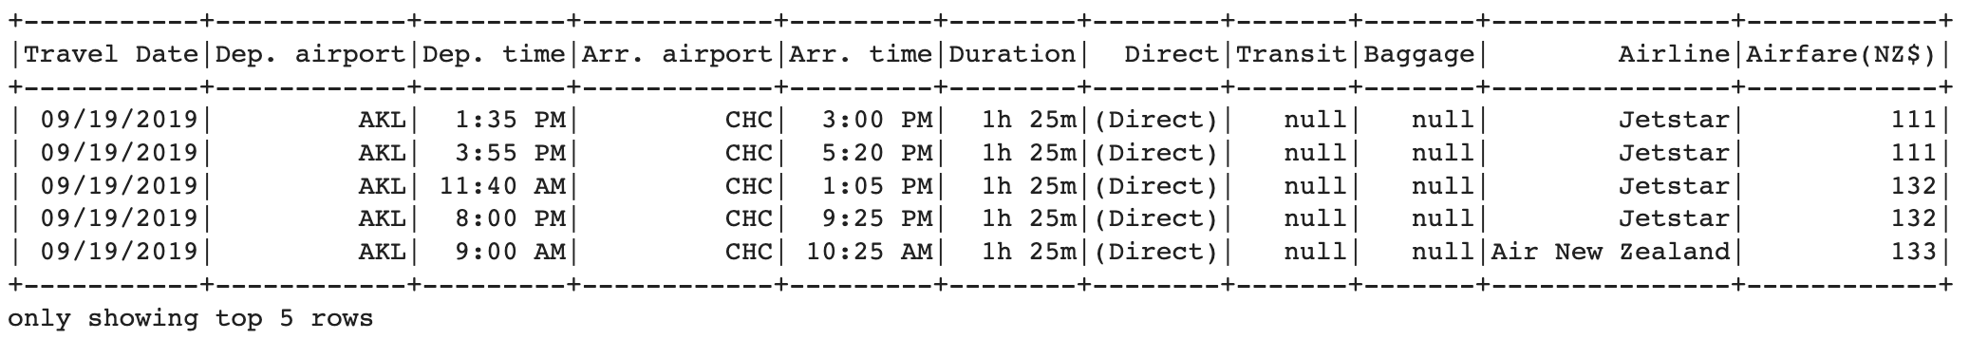
Data Set Overview
Overview: By analyzing all the independent features with our dependent variable(Airfare) we will be predicting the price of the fare.
We have 162833 rows and 11 columns.
Interesting Facts:
The data was collected by Expedia group, one of the biggest online travel company and it is from Year 2019.
Major airlines in NZ are ‘Air New Zealand’ , ‘Jetsar’ and ‘SoundsAir’.
The data set ranges from 19th September 2019 to 18th December 2019, a total of 90 days.

Slide 4
Data Pre-Processing
One of the main aspect in Data Science is before we start creating machine learning models is to pre-process the data.
In our data set one of the major challenge was to set the right format for ‘Travel Date’ column.
Data that we got from the source had 80,000 records in date format and the rest of them were in string format.
So, we had to maintain the date format i.e., ‘YYYY-MM-DD’.
Missing Values:
Imputing the above missing values with the required ‘values’ and dropping 53 records in total from Departure Airport, Arrival Airport and Arrival Time.
Attribute | Missing Value Count
Departure Airport | 24
Arrival Airport | 24
Arrival Time | 5
Transit | 39756
Baggage | 160522
Airline | 5

Slide 5
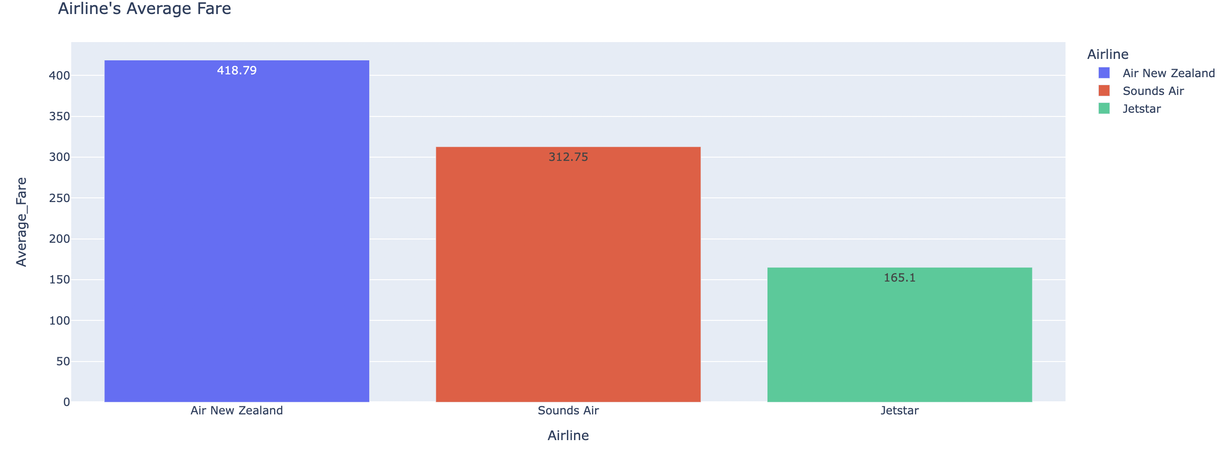
Exploratory Data Analysis
Average Fare v/s Airline
Plotly library was used for EDA.
Air New Zealand has the highest average fare i.e., $418.79 and the cheapest option is given by Jetstar for $165.1
Airline vs Average Fare

Slide 6
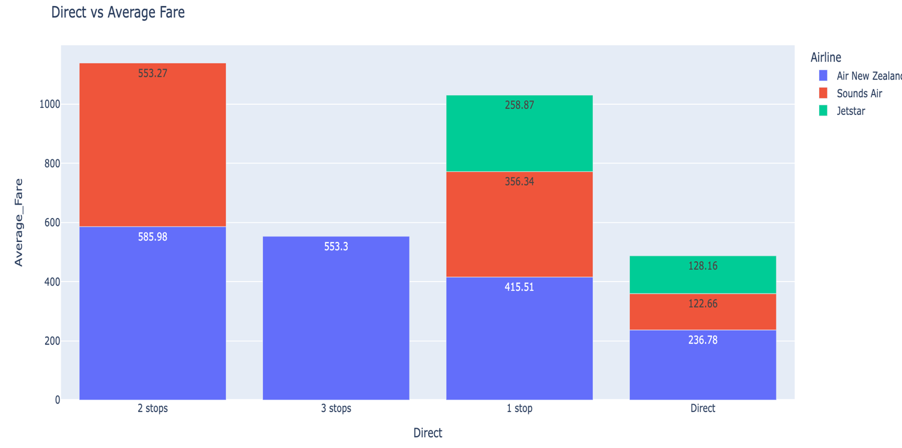
Exploratory Data Analysis
Average Fare v/s Direct
Now, when we transition from one place to other there are 4 possibilities : Direct Flights, 1 stop, 2 stops and 3 stops.
As per the data direct flights are the cheapest option for all passengers as seen from the stacked bar chart.
Direct vs Average Fare

Slide 7
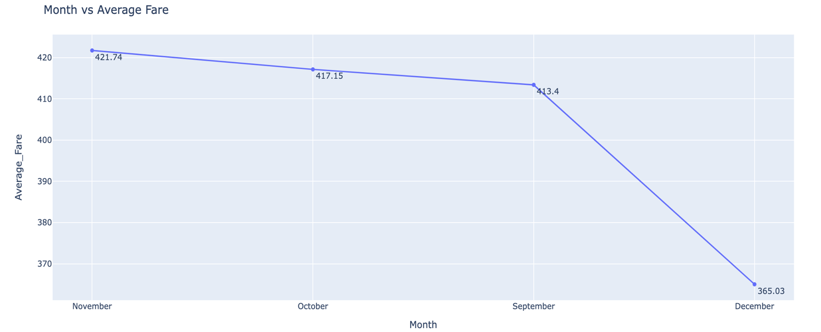
Exploratory Data Analysis
Average Fare v/s Month
We always make travel plans when we find the fare to be the cheapest.
As per our data, flights in New Zealand have less fare in December i.e., $365.03 if the booking is done well in advance.
Month vs Average Fare

Slide 8
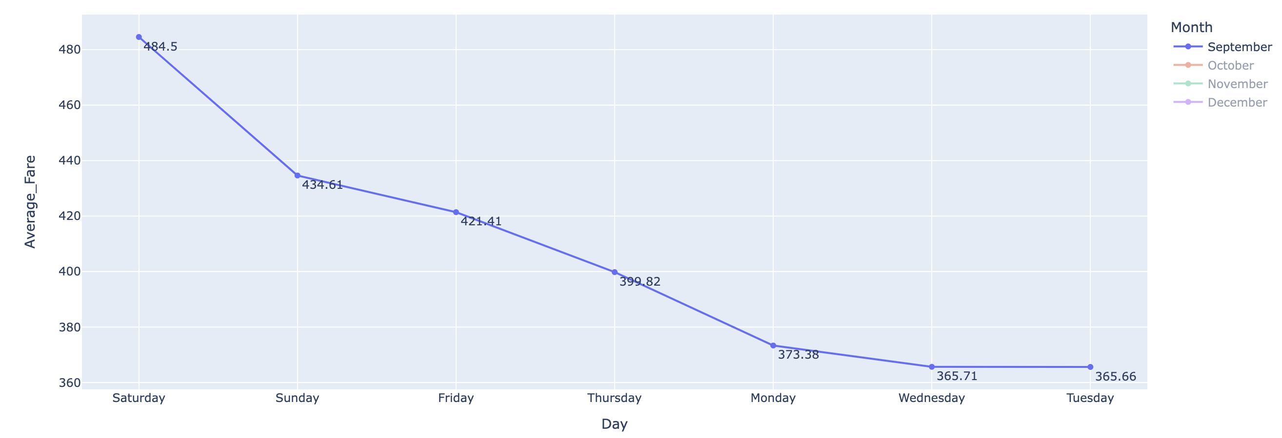
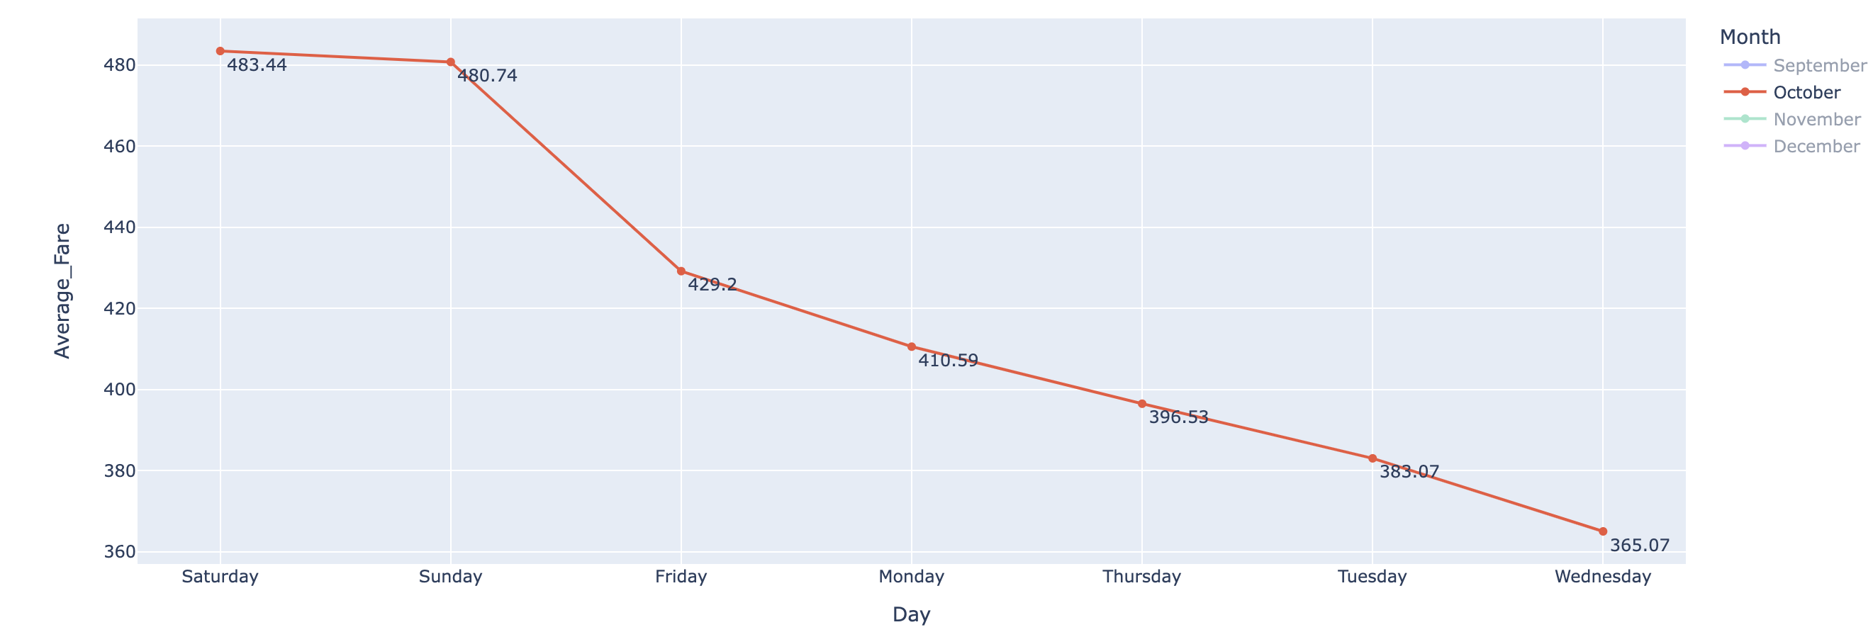
Exploratory Data Analysis
Average Fare v/s Day
From the travel date we extracted the day as well and based on that we found out on which day we had the fare to be expensive and cheapest for each flight.
Both in September and October we have high fare on weekends(Saturday and Sunday) as compared to Weekdays.
September
October
Day vs Average Fare

Slide 9
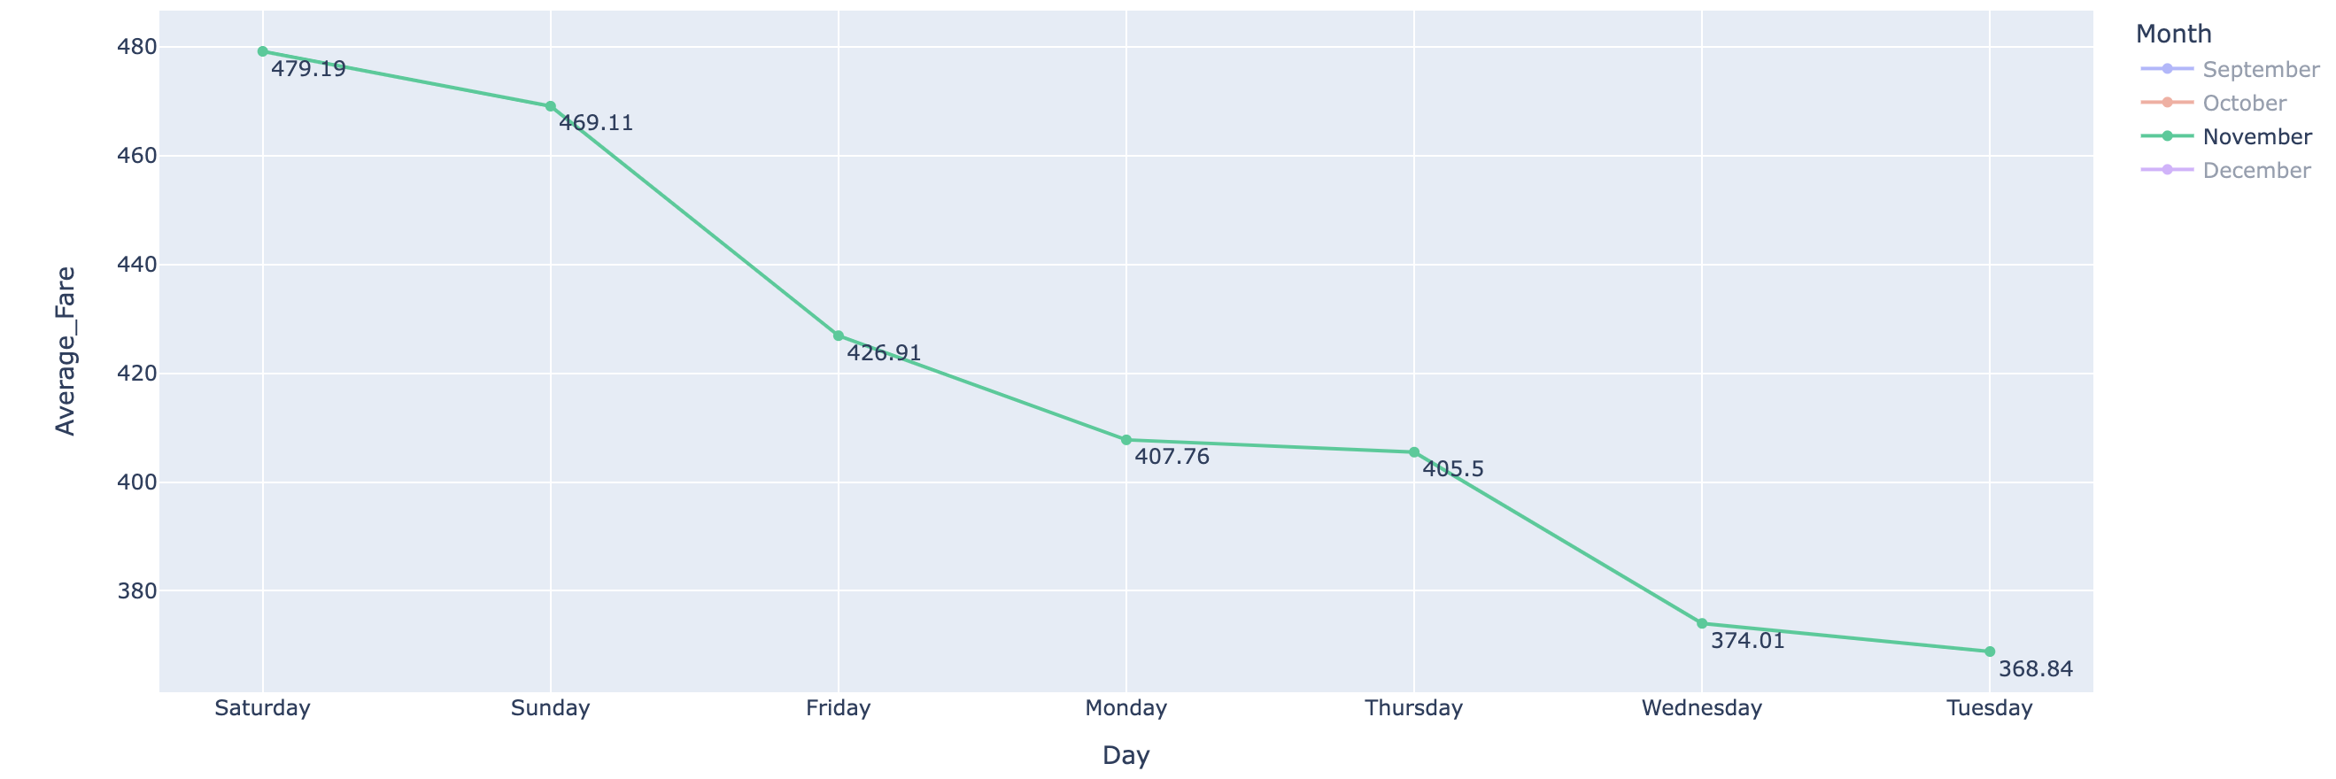
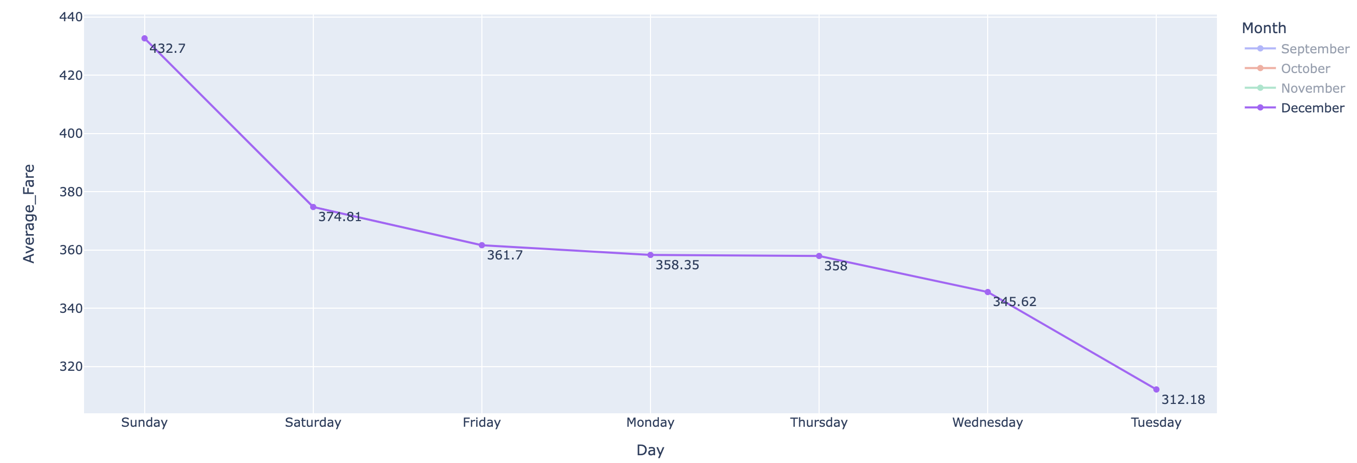
Exploratory Data Analysis
Average Fare v/s Day
From the travel date we extracted the day as well and based on that we found out on which day we had the fare to be expensive and cheapest for each flight.
Both in November and December as well we have high fare on weekends(Saturday and Sunday) as compared to Weekdays.
November
Day vs Average Fare
December

Slide 10
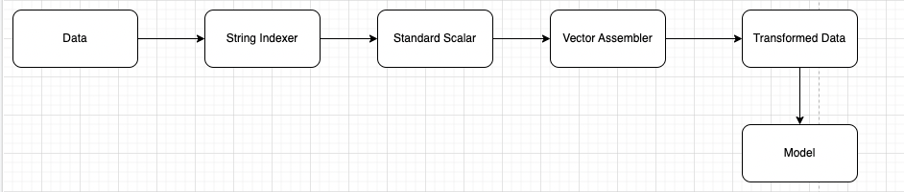
Machine Learning Models
Feature Engineering methodologies like String Indexer, Vector Assembler and Standard Scaler were used to get the data ready for deploying machine learning models.
Pipelines were built to automate the machine learning workflow by enabling data to be transformed and correlated into a model.
Regression models – Linear Regression, Random Forest Regressor and Gradient Boosting Regressor were used to understand how the air fares were varying for three different airlines.
Pipeline

Slide 11
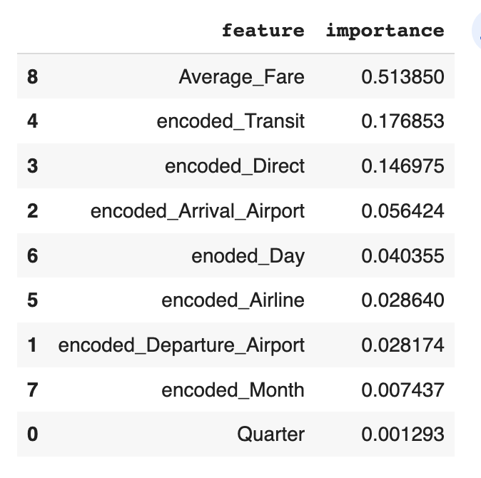
Summary of Methods
To analyze how air costs varied for three different airlines, regression models such as Linear Regression, Random Forest Regressor, and Gradient Boosting Regressor were utilized.
Linear regression being the simplest of the regression techniques, was used to check the MSE and R-squared value.
Next, we used Random Forest Regressor as it allows more exploration of features and the feature importance of every attribute that is present in the data.
To further enhance the accuracy of the model, we made use of Gradient boosting model as this would help us achieve a sequential models by combining weak learners into strong ones.
Hyperparameter Tuning Parameters
Random Forest | Gradient Boosting Regressor
Num Trees=[5,10] | Max Iter=[5,10]
Max Depth=[5,10] | Max Depth=[5,10]
Tuning Parameters
Feature Importance

Slide 12
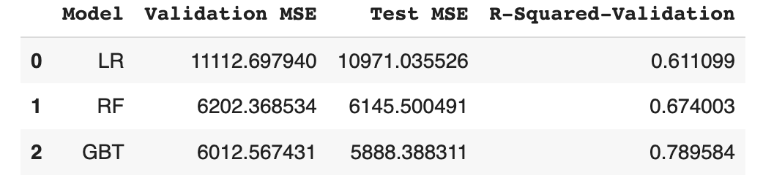
Result Summary
Regression Model
The main objective of using regression models was to minimize the loss by observing the mean squared error.
The data was split into train-validation-test set. (60:20:20)
The mean squared error for different regressions are as follows:
Linear Regression
Validation: 11112.697
Test: 10971.03
Random Forest Regressor
Validation: 6316.32
Test: 6243.68
Gradient Boost Regressor
Validation: 6012.56
Test: 5888.38
We also checked the model accuracy on both validation and test set by observing the R-squared value.
Gradient Boosting has performed better than all other models as it has the least MSE and high accuracy of 78.9%.
Resulting DataFrame

Slide 13
Thank You

